Slide 1


Computer Networks
Lectures (Chapter3)
Transport Layer
Subhan Ullah, PhD
subhan.ullah@nu.edu.pk
BS(Computer Science) Fall-2022

Slide 2
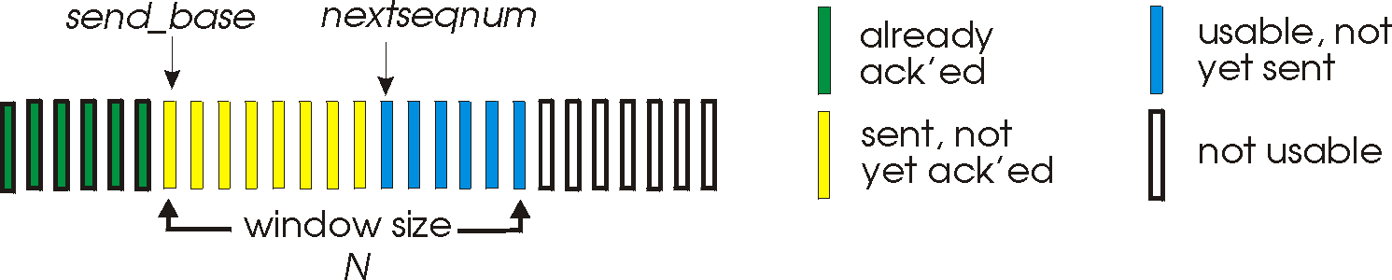
Go-Back-N: sender
sender: “window” of up to N, consecutive transmitted but unACKed pkts
k-bit seq # in pkt header
cumulative ACK: ACK(n): ACKs all packets up to, including seq # n
on receiving ACK(n): move window forward to begin at n+1
timer for oldest in-flight packet
timeout(n): retransmit packet n and all higher seq # packets in window
Notes:
window size of 14, 8 have been sent but are not yet acknowledged m 6 sequence numbers are available for us. In window, but no calls from above to use them.
Note – we’ll skip the Go-Back-N FSM specification you can check that out in powerpoint slides or book)
TCP uses cumulative ACK

Slide 3
Go-Back-N: receiver
ACK-only: always send ACK for correctly-received packet so far, with highest in-order seq #
may generate duplicate ACKs
need only remember rcv_base
on receipt of out-of-order packet:
can discard (don’t buffer) or buffer: an implementation decision
re-ACK pkt with highest in-order seq #
Receiver view of sequence number space:
received and ACKed
…
…
Out-of-order: received but not ACKed
rcv_base
Not received
Notes:
Note – we’ll skip the Go-Back-N FSM specification (actually it’s

Slide 4

Go-Back-N in action
sender window (N=4)
sender
receiver
0 1 2 3 4 5 6 7 8
send pkt0
send pkt1
send pkt2
send pkt3
(wait)
0 1 2 3 4 5 6 7 8
receive pkt0, send ack0
receive pkt1, send ack1
receive pkt3, discard,
(re)send ack1
0 1 2 3 4 5 6 7 8
X
0 1 2 3 4 5 6 7 8
loss
0 1 2 3 4 5 6 7 8
rcv ack0, send pkt4
0 1 2 3 4 5 6 7 8
rcv ack1, send pkt5
receive pkt4, discard,
(re)send ack1
ignore duplicate ACK
receive pkt5, discard,
(re)send ack1
pkt 2 timeout
0 1 2 3 4 5 6 7 8
send pkt2
send pkt3
send pkt4
send pkt5
0 1 2 3 4 5 6 7 8
0 1 2 3 4 5 6 7 8
rcv pkt2, deliver, send ack2
rcv pkt3, deliver, send ack3
rcv pkt4, deliver, send ack4
rcv pkt5, deliver, send ack5
0 1 2 3 4 5 6 7 8
Applets for Go-Back-N
https://computerscience.unicam.it/marcantoni/reti/applet/GoBackProtocol/goback.html
https://media.pearsoncmg.com/aw/ecs_kurose_compnetwork_7/cw/content/interactiveanimations/go-back-n-protocol/index.html
Notes:
Let’s skip FSM specification for GBN – check out the book or ppt – and let’s watch GBN sender and receivers in action.
Let assume a window size of 4. at t=0, sender sends packets 0, 1, 2 3, 4, and packet 2 will be lost
At the receiver:
Packet 0 received ACK0 generated
Packet 1 received ACK1 generated
Packet 2 is lost, and so when packet 3 is received, ACK 1 is sent – that’s the cumulative ACK, re-Acknowledging the receipt of packet 1. and in this implementation packet 3 is discarded

Slide 5
GBN: sender extended FSM
rdt_send(data)
First, check if window is full,
if not send and update variables
N is the window size
base=oldest unack’ed
nextseqnum=seqno of next pckt
if (nextseqnum < base+N) {
sndpkt[nextseqnum] = make_pkt(nextseqnum,data,chksum)
udt_send(sndpkt[nextseqnum])
if (base == nextseqnum)
start_timer
nextseqnum++
}
else
refuse_data(data)
Timer associated with oldest unacked
base == nextseqnum, when?
Λ
base=1
nextseqnum=1
timeout
On timeout resend all
unack’ed packets
Wait
start_timer
udt_send(sndpkt[base])
udt_send(sndpkt[base+1])
…
udt_send(sndpkt[nextseqnum-1])
Why wait?
rdt_rcv(rcvpkt)
&& corrupt(rcvpkt)
Λ
Cumulative ACKs, receiver only
ACKs when packets delivered
in order.
Here we need to update base
and stop timer if nothing to send
or restart if some pckts left
rdt_rcv(rcvpkt) &&
notcorrupt(rcvpkt)
base = getacknum(rcvpkt)+1
If (base == nextseqnum)
stop_timer
else
start_timer
Notes:
Section D (topic covered: 28-10-2021)

Slide 6
GBN: receiver extended FSM
default
udt_send(sndpkt)
rdt_rcv(rcvpkt)
&& notcurrupt(rcvpkt)
&& hasseqnum(rcvpkt,expectedseqnum)
Λ
Wait
extract(rcvpkt,data)
deliver_data(data)
sndpkt = make_pkt(expectedseqnum,ACK,chksum)
udt_send(sndpkt)
expectedseqnum++
expectedseqnum=1
sndpkt =
make_pkt(expectedseqnum-1,ACK,chksum)
ACK-only: always send ACK for correctly-received pkt with highest in-order seq #
may generate duplicate ACKs
need only remember expectedseqnum
out-of-order pkt:
discard (don’t buffer): no receiver buffering!
re-ACK pkt with highest in-order seq #

Slide 7
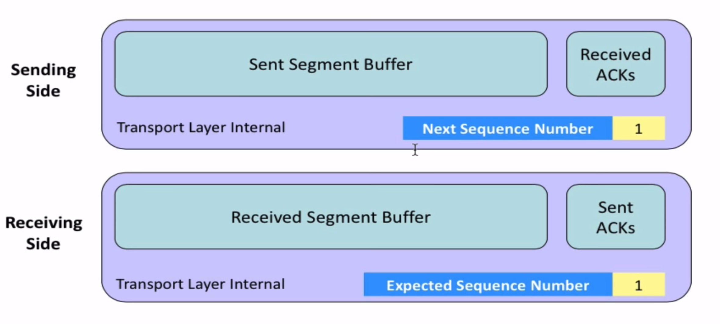
Go-Back-N

Slide 8
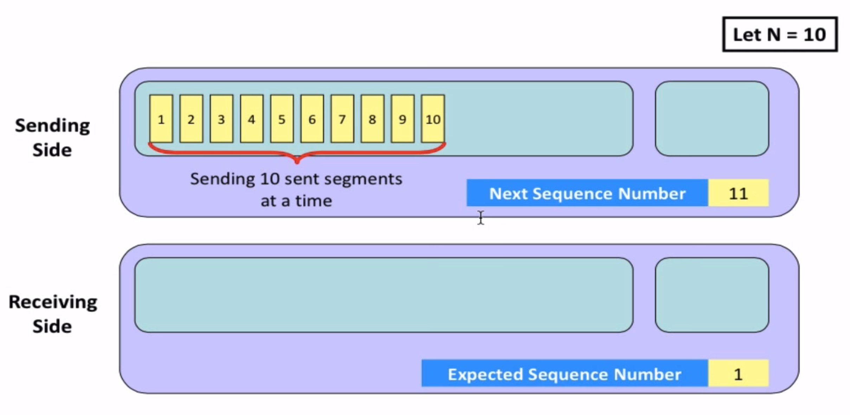
Go-Back-N

Slide 9
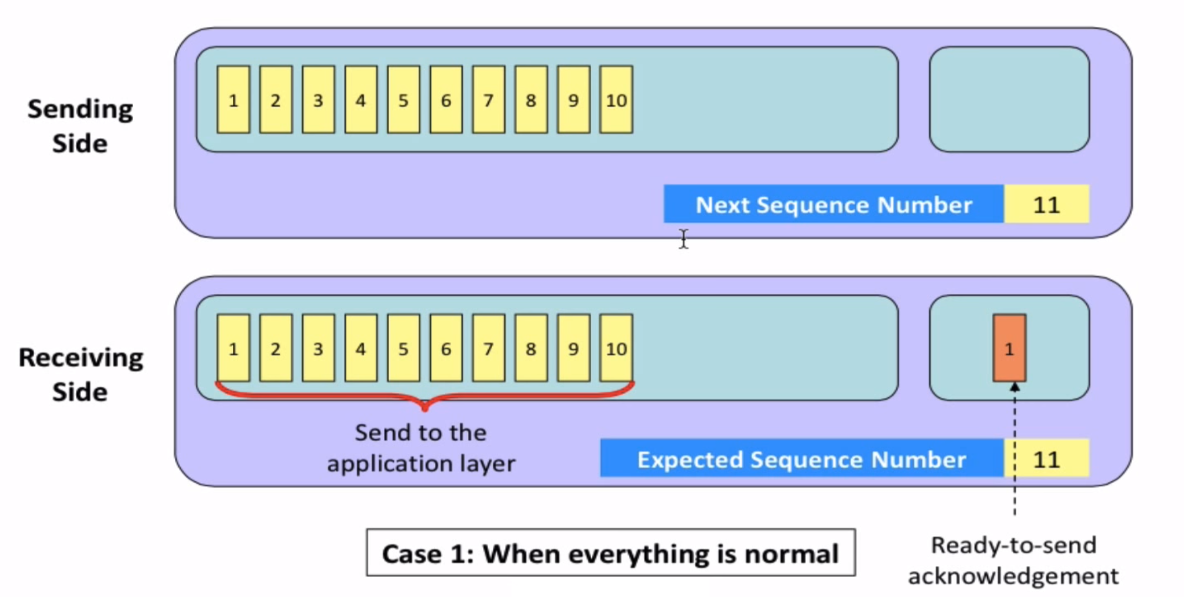
Go-Back-N

Slide 10
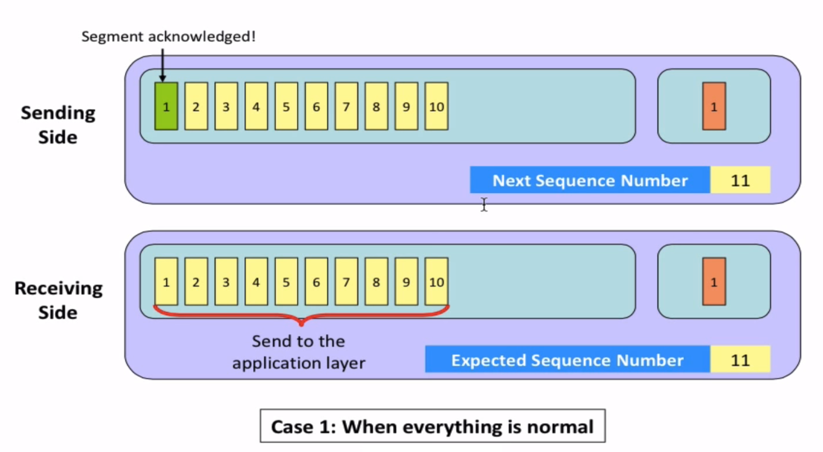
Go-Back-N

Slide 11
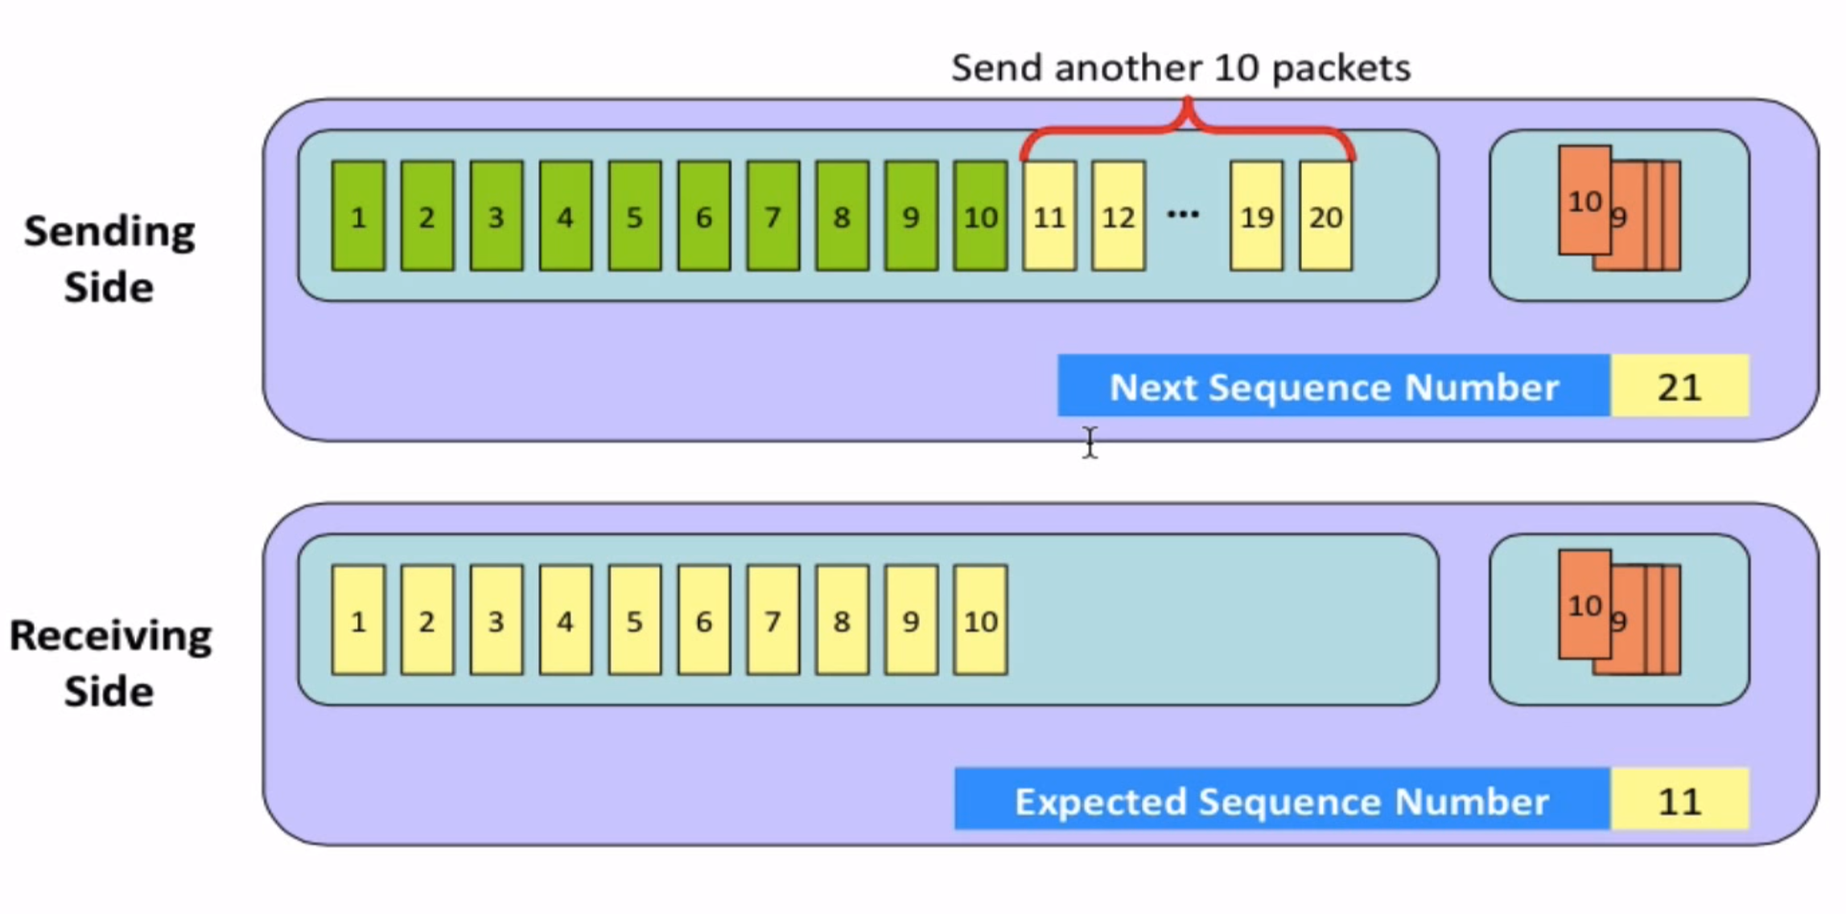
Go-Back-N

Slide 12
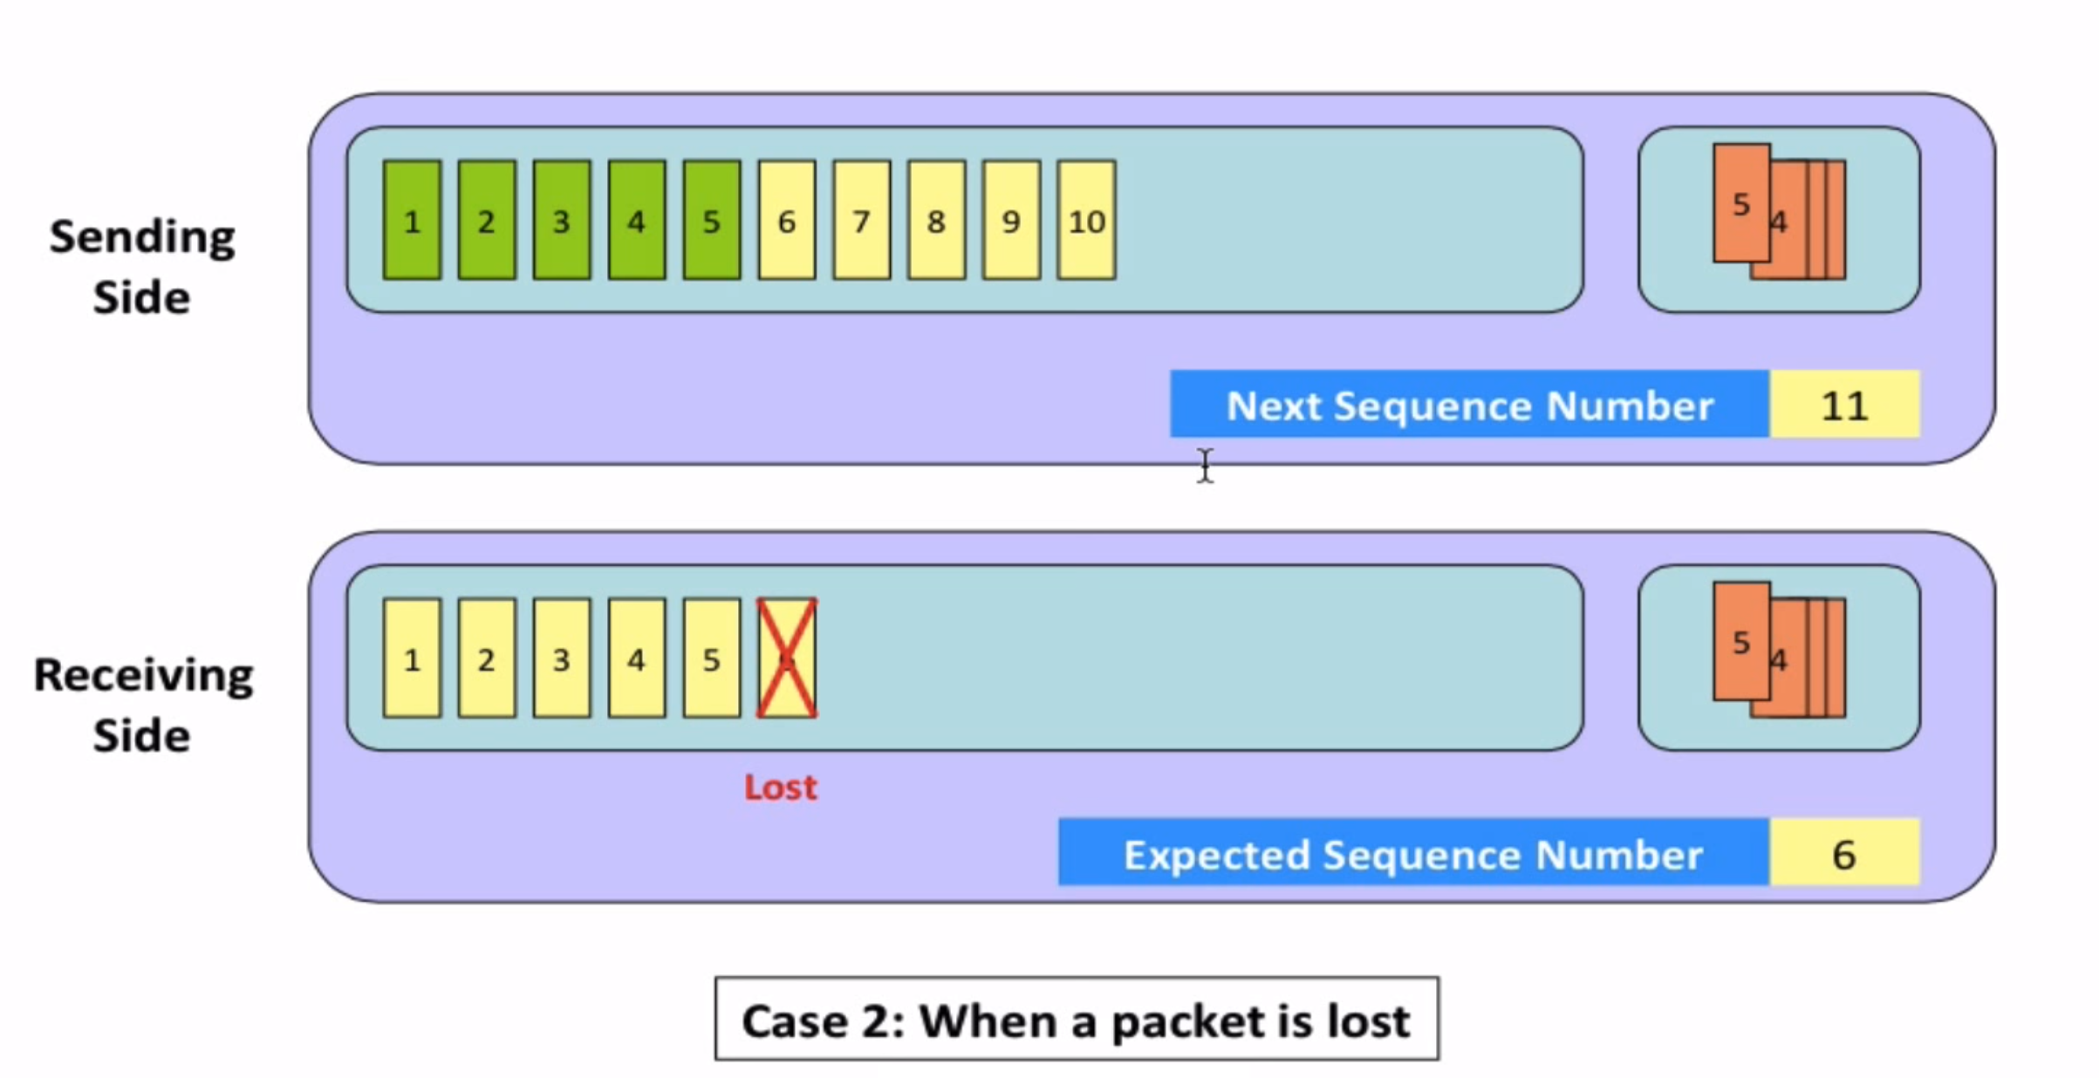
Go-Back-N

Slide 13
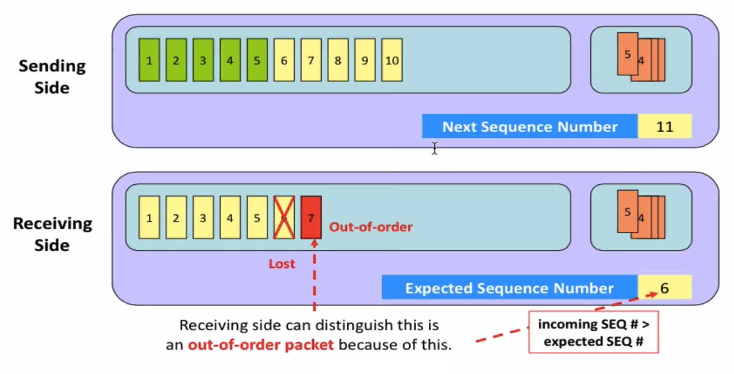
Go-Back-N

Slide 14
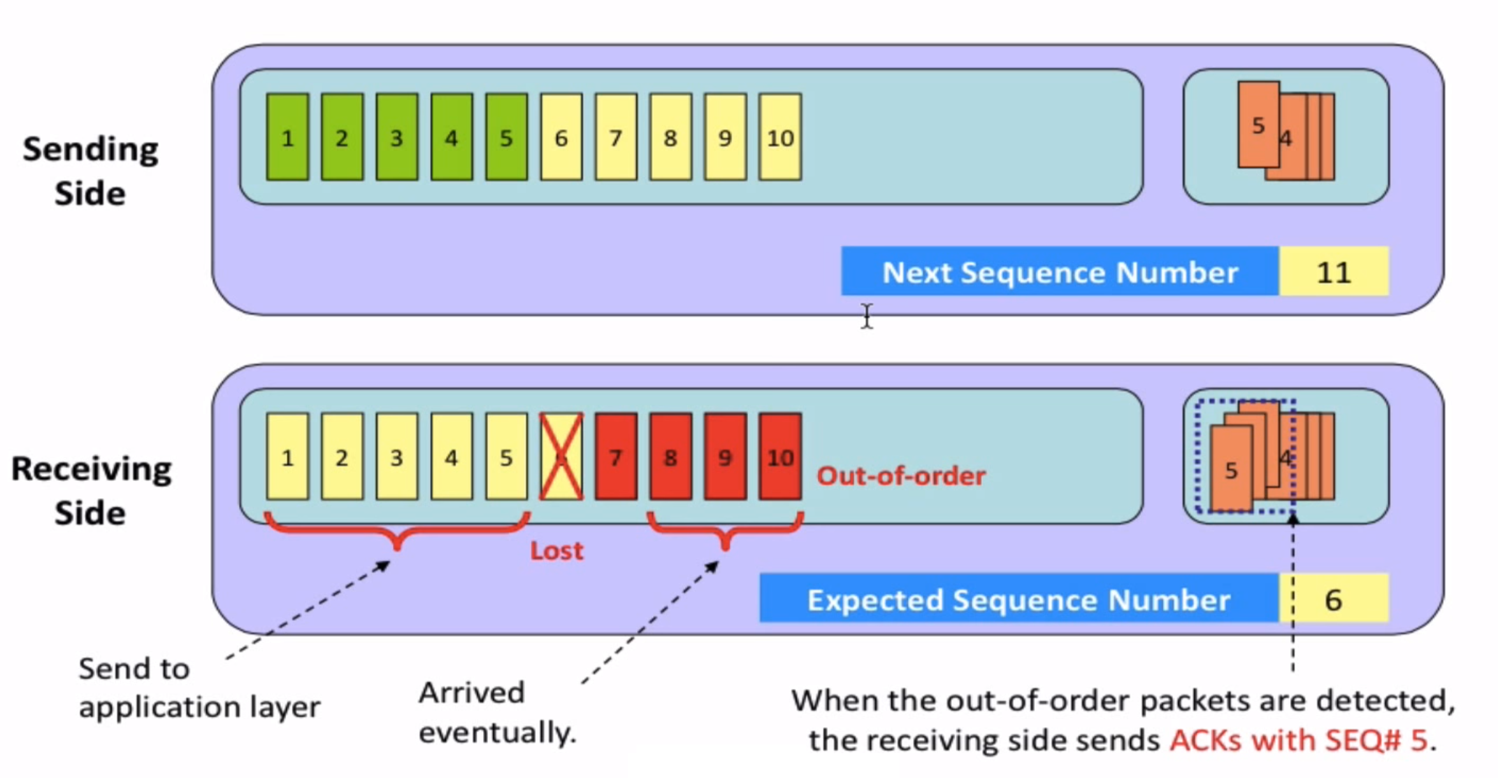
Go-Back-N

Slide 15
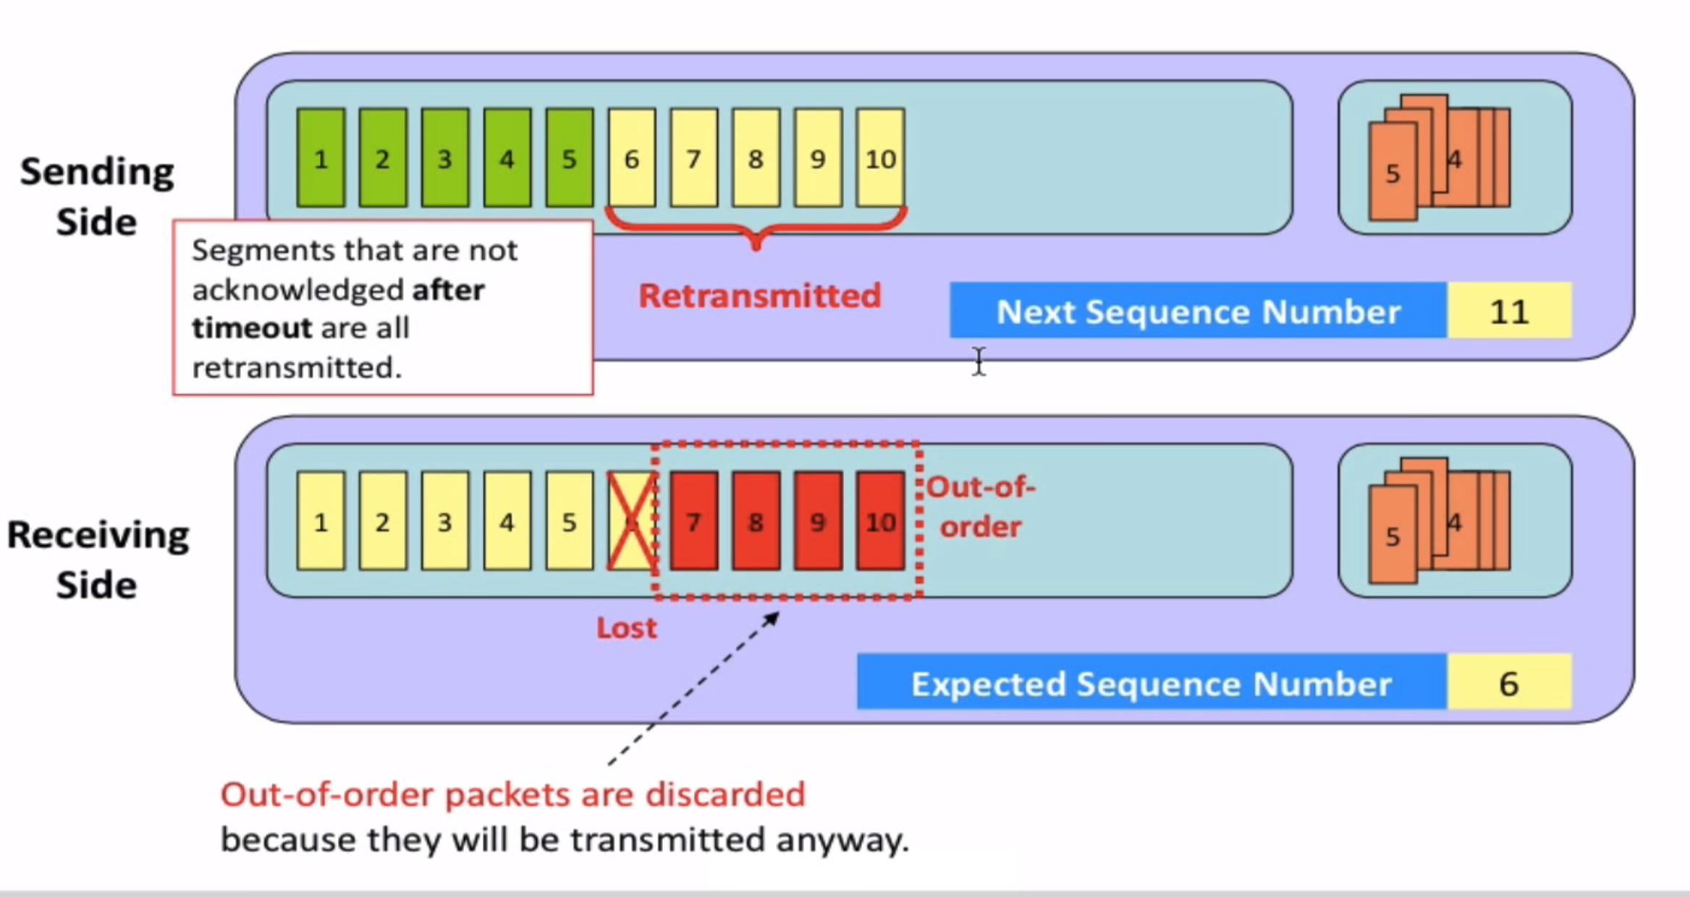
Go-Back-N

Slide 16
Go-Back-N
Why N? why not having an unbound window size?
Answer:
Having an unbound window size means to end up with an unbound number of unacknowledge segments
An unbound window size means bombarding the buffers on the network devices along the traffic path as well as the buffer on the destination

Slide 17
Selective repeat
receiver individually acknowledges all correctly received packets
buffers packets, as needed, for eventual in-order delivery to upper layer
sender times-out/retransmits individually for unACKed packets
sender maintains timer for each unACKed pkt
sender window
N consecutive seq #s
limits seq #s of sent, unACKed packets
Notes:
An important mechanism of GBN was the use of the cumulative acknowledgements, and as we mentioned, cumulative ACKs are used in TCP
An alternate ACK mechanism would be for the receiver to individually acknowledge specific packets as they are received. This mechanism is at the heart of the Selective repeat protocol.

Slide 18
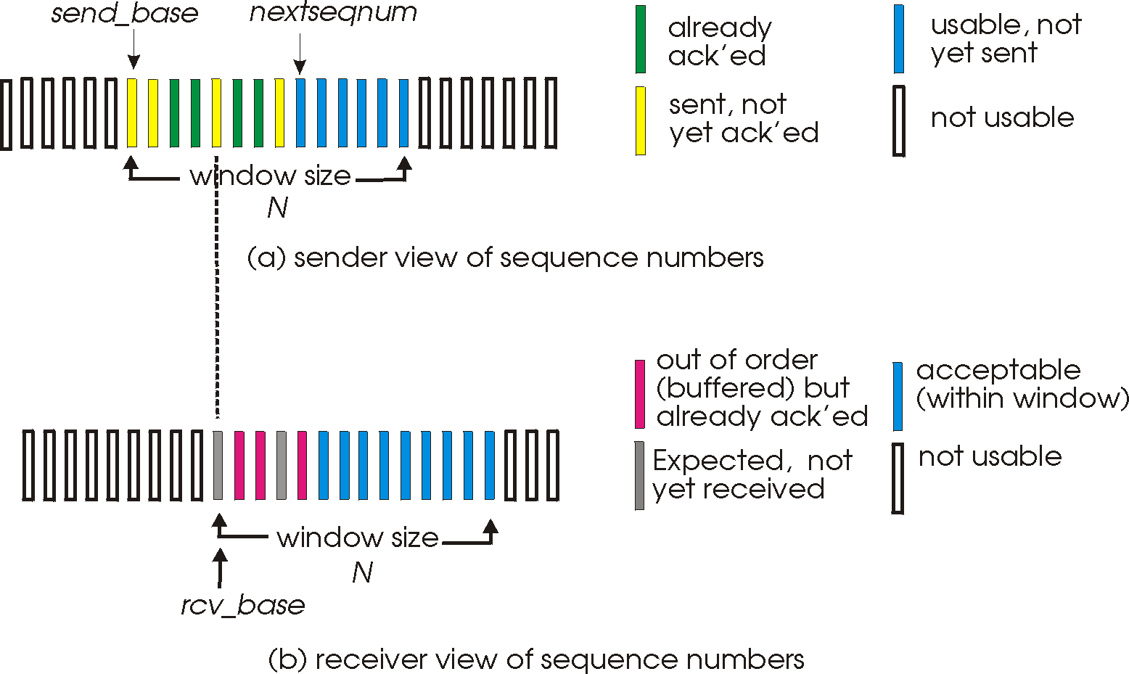
Selective repeat: sender, receiver windows

Slide 19
Selective repeat: sender and receiver
sender
receiver
data from above:
if next available seq # in window, send packet
timeout(n):
resend packet n, restart timer
ACK(n) in [sendbase, sendbase+N]:
mark packet n as received
if n smallest unACKed packet, advance window base to next unACKed seq #
packet n in [rcvbase, rcvbase+N-1]
send ACK(n)
out-of-order: buffer
in-order: deliver (also deliver buffered, in-order packets), advance window to next not-yet-received packet
packet n in [rcvbase-N,rcvbase-1]
ACK(n)
otherwise:
ignore
Notes:
Section E and F topic covered ( only theory is remaining) of this slide…
If the packet is in order, its data will be delivered, as will any buffered data that can now be delivered in order

Slide 20
Selective Repeat in action
sender window (N=4)
sender
receiver
0 1 2 3 4 5 6 7 8
send pkt0
send pkt1
send pkt2
send pkt3
(wait)
0 1 2 3 4 5 6 7 8
receive pkt0, send ack0
receive pkt1, send ack1
receive pkt3, buffer,
send ack3
0 1 2 3 4 5 6 7 8
X
0 1 2 3 4 5 6 7 8
loss
0 1 2 3 4 5 6 7 8
rcv ack0, send pkt4
0 1 2 3 4 5 6 7 8
rcv ack1, send pkt5
receive pkt4, buffer,
send ack4
record ack3 arrived
receive pkt5, buffer,
send ack5
pkt 2 timeout
0 1 2 3 4 5 6 7 8
send pkt2
(but not 3,4,5)
0 1 2 3 4 5 6 7 8
0 1 2 3 4 5 6 7 8
rcv pkt2; deliver pkt2,
pkt3, pkt4, pkt5; send ack2
0 1 2 3 4 5 6 7 8
Q: what happens when ack2 arrives?
Applets for Selective repeat:
https://computerscience.unicam.it/marcantoni/reti/applet/SelectiveRepeatProtocol/selRepProt.html
https://media.pearsoncmg.com/aw/ecs_kurose_compnetwork_7/cw/content/interactiveanimations/selective-repeat-protocol/index.html

Slide 21
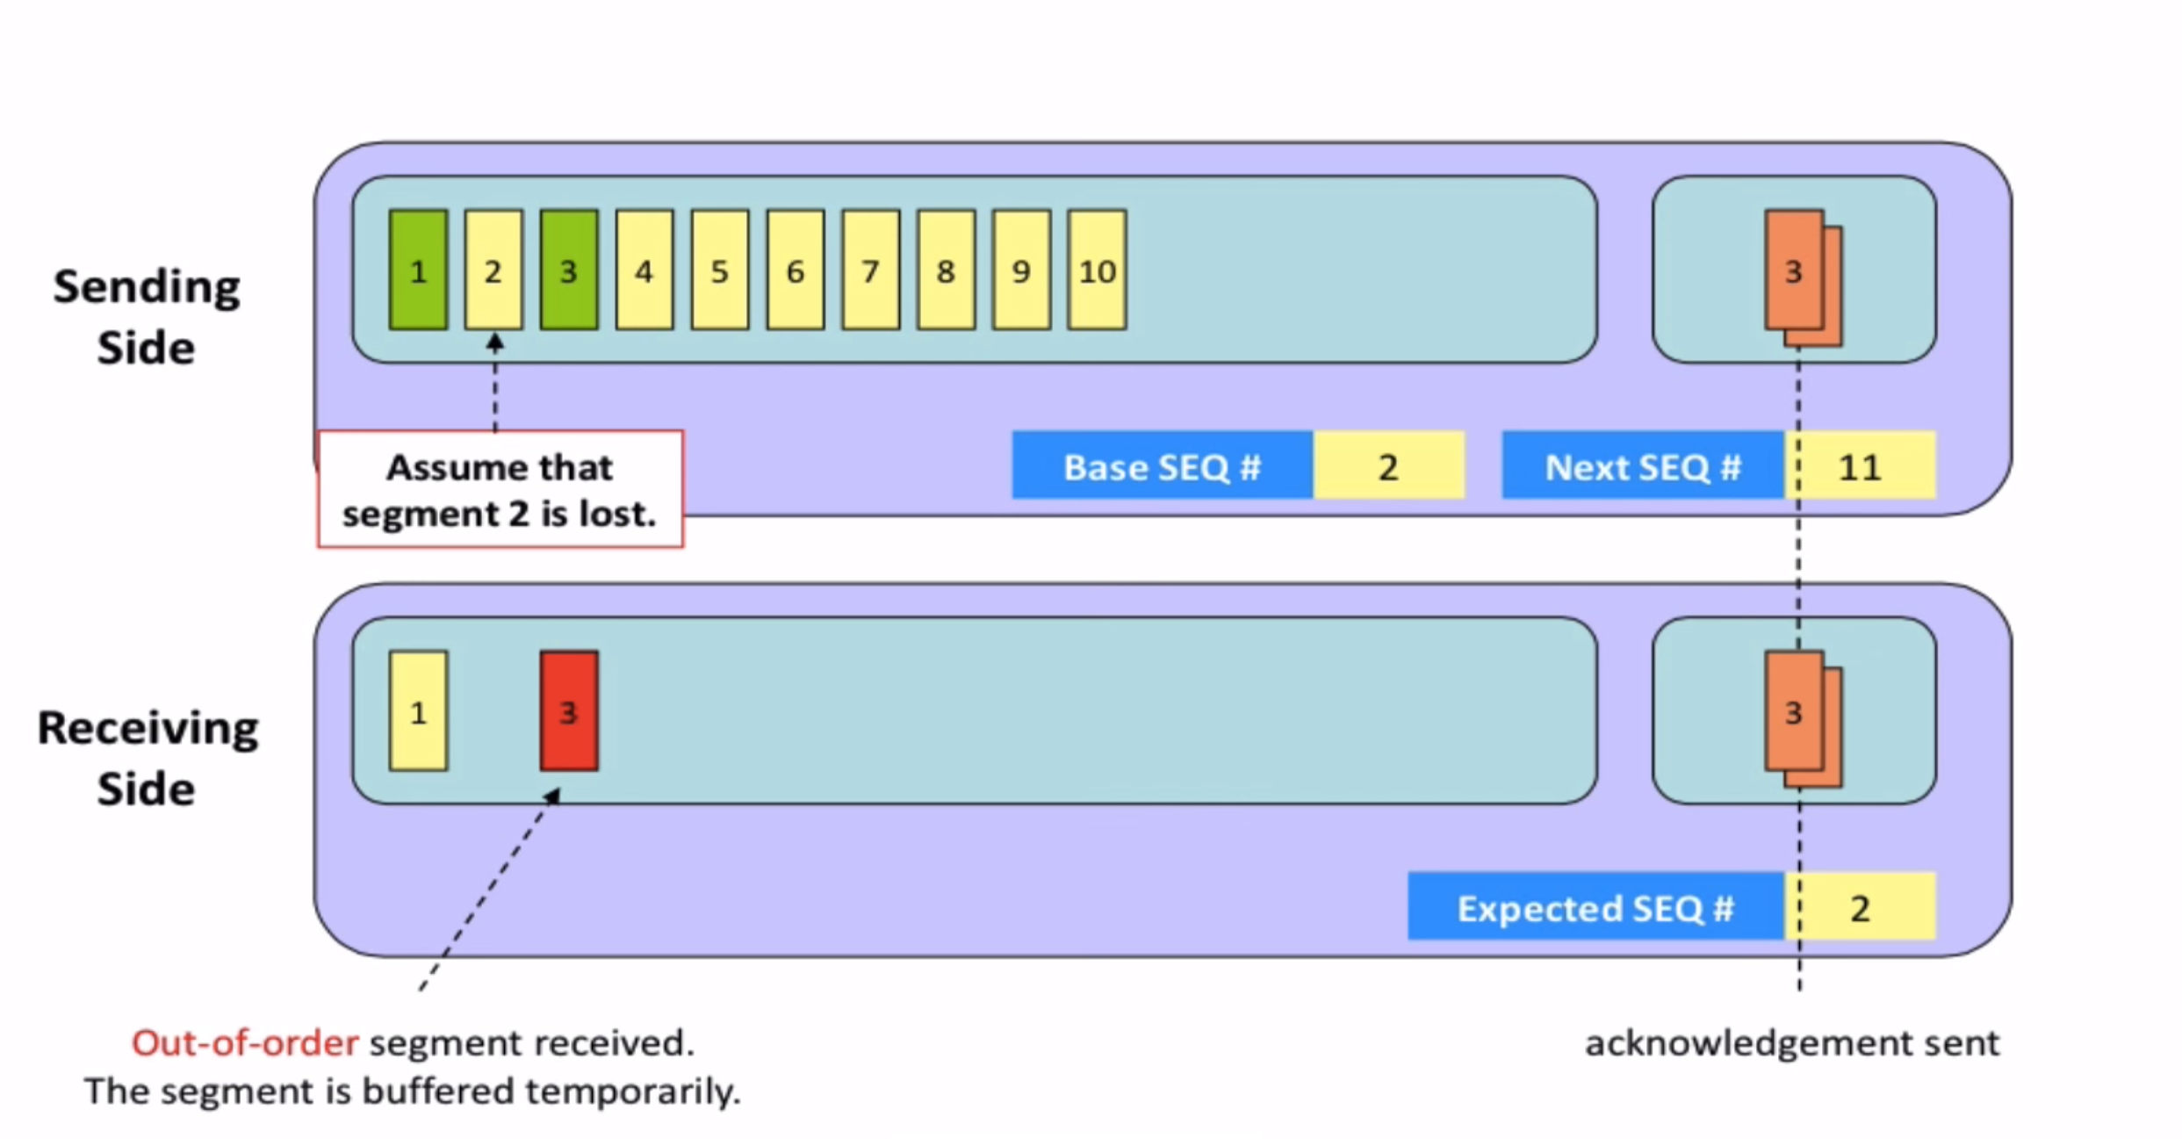
Selective repeat

Slide 22
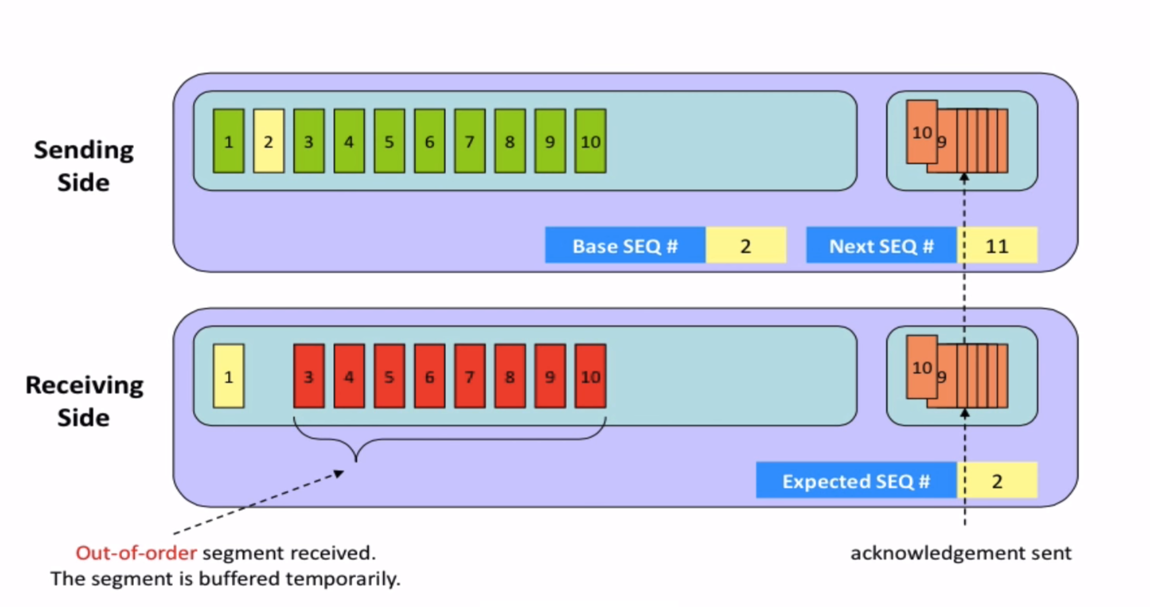
Selective repeat

Slide 23
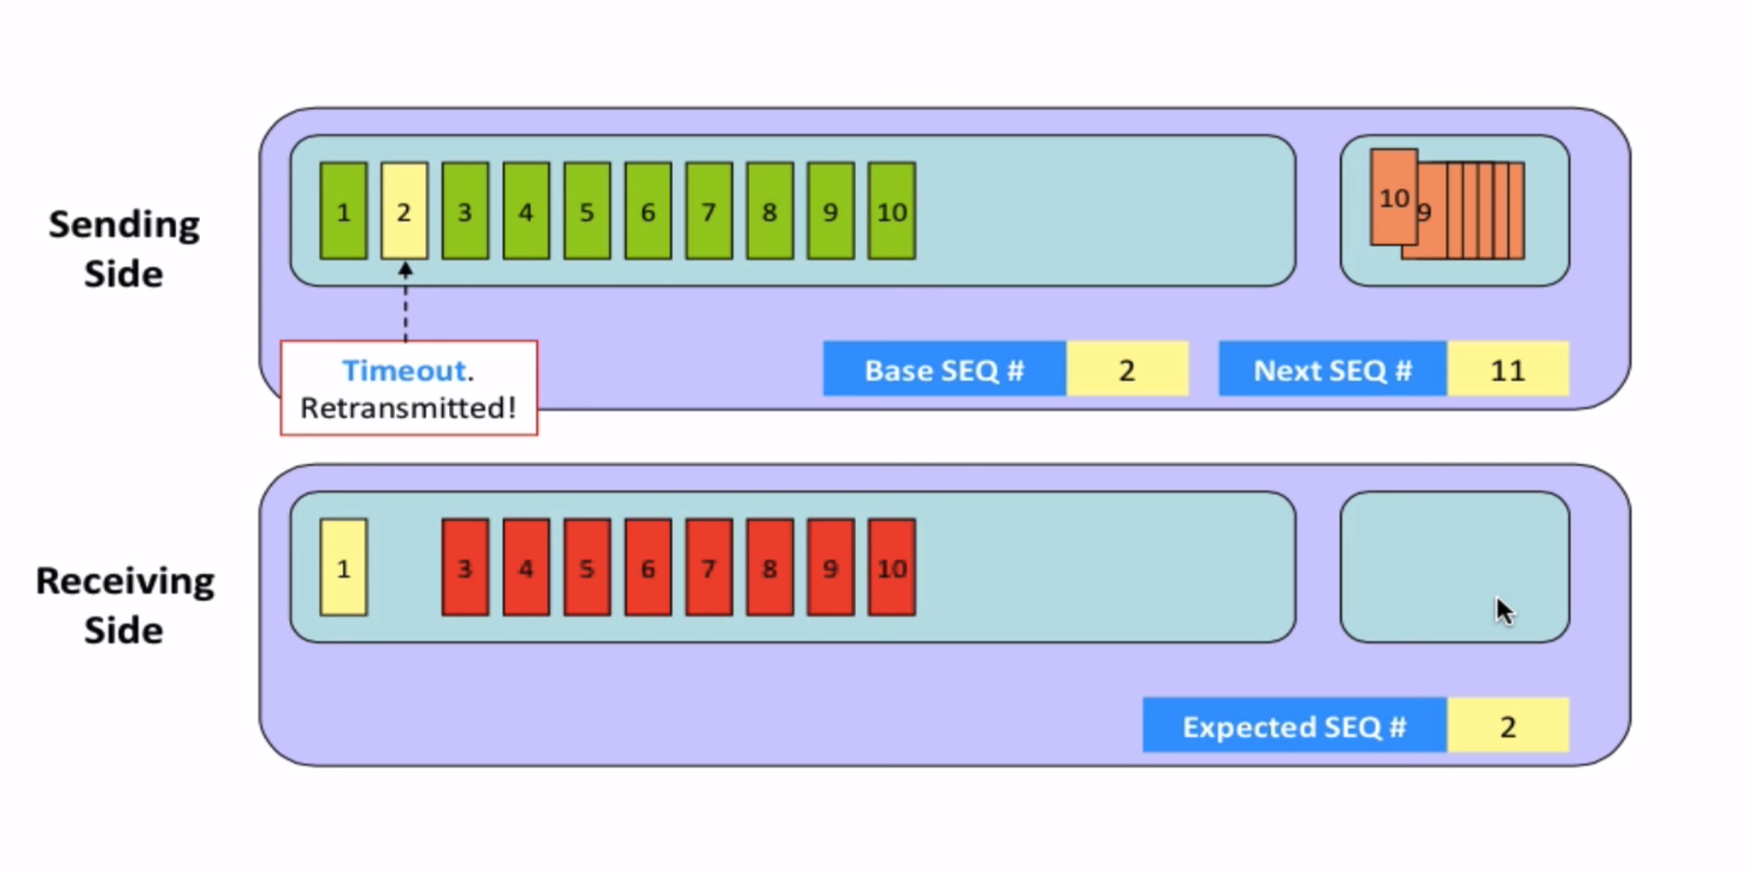
Selective repeat

Slide 24
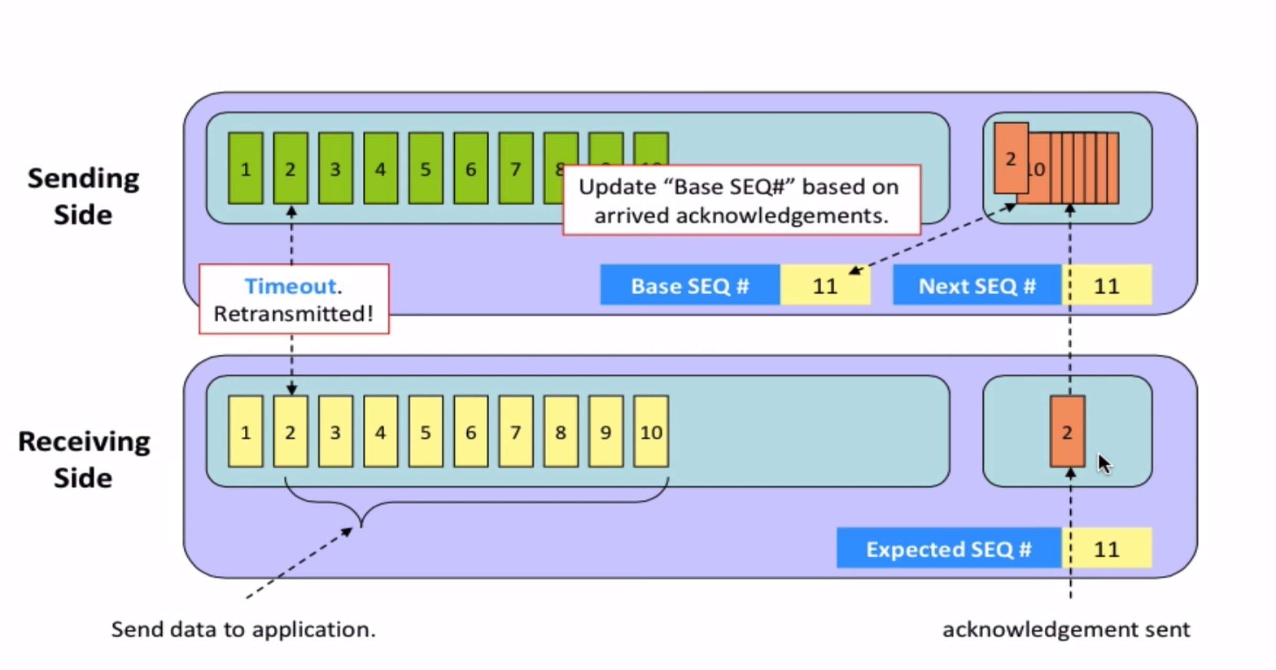
Selective repeat

Slide 25
Selective repeat: a dilemma!
sender window
(after receipt)
receiver window
(after receipt)
0 1 2 3 0 1 2
pkt0
0 1 2 3 0 1 2
pkt1
0 1 2 3 0 1 2
0 1 2 3 0 1 2
pkt2
0 1 2 3 0 1 2
example:
seq #s: 0, 1, 2, 3 (base 4 counting)
window size=3
0 1 2 3 0 1 2
0 1 2 3 0 1 2
pkt3
X
0 1 2 3 0 1 2
pkt0
will accept packet
with seq number 0
(a) no problem
0 1 2 3 0 1 2
pkt0
0 1 2 3 0 1 2
pkt1
0 1 2 3 0 1 2
0 1 2 3 0 1 2
pkt2
X
0 1 2 3 0 1 2
X
0 1 2 3 0 1 2
X
timeout
retransmit pkt0
0 1 2 3 0 1 2
pkt0
will accept packet
with seq number 0
(b) oops!

Slide 26

Selective repeat: a dilemma!
sender window
(after receipt)
receiver window
(after receipt)
0 1 2 3 0 1 2
pkt0
0 1 2 3 0 1 2
pkt1
0 1 2 3 0 1 2
0 1 2 3 0 1 2
pkt2
0 1 2 3 0 1 2
example:
seq #s: 0, 1, 2, 3 (base 4 counting)
window size=3
0 1 2 3 0 1 2
0 1 2 3 0 1 2
pkt3
X
0 1 2 3 0 1 2
receiver can’t see sender side
receiver behavior identical in both cases!
something’s (very) wrong!
pkt0
will accept packet
with seq number 0
(a) no problem
Q: what relationship is needed between sequence # size and window size to avoid problem in scenario (b)?
pkt0
0 1 2 3 0 1 2
0 1 2 3 0 1 2
pkt1
0 1 2 3 0 1 2
0 1 2 3 0 1 2
pkt2
X
0 1 2 3 0 1 2
X
0 1 2 3 0 1 2
X
timeout
retransmit pkt0
0 1 2 3 0 1 2
pkt0
A: Window size should be less than or
equal to half the sequence number.
will accept packet
with seq number 0
(b) oops!
Notes:
Window size should be less than or equal to half the sequence number in SR protocol. This is to avoid packets being recognized incorrectly. If the size of the window is greater than half the sequence number space, then if an ACK is lost, the sender may send new packets that the receiver believes are retransmissions.
Packets reordering:
Because sequence numbers may be reused, some care must be taken to guard against such duplicate packets
In practice, we need to ensure that a sequence number is not reused until the sender is “sure” that any previously sent packets with sequence number x are no longer in the network.
How it can be done?
This is done by assuming that a packet cannot “live” in the network for longer than some fixed maximum amount of time.
A maximum packet lifetime of approximately three minutes is assumed in the TCP extensions

Slide 27
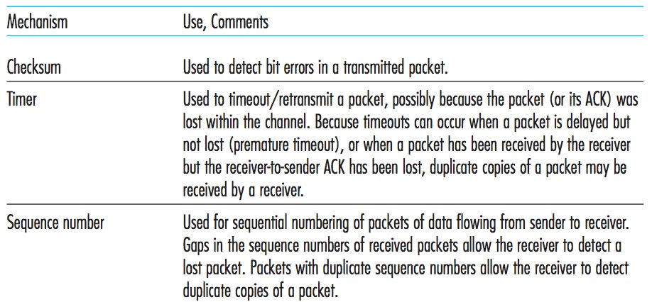
Summary

Slide 28
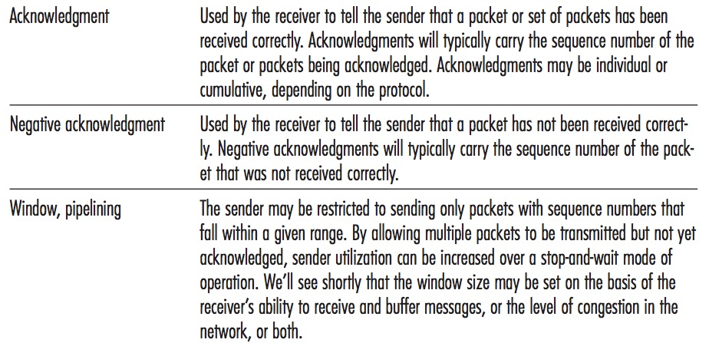
Summary

Slide 29


Thank You All
☺
?
A note on the origin of these ppt slides:
All material copyright 1996-2020 J.F Kurose and K.W. Ross, All Rights Reserved
These slides are freely provided by the book authors and it represents a lot of work on their part. We would like to thank J.F Kurose and K.W. Ross.
Transport Layer: 3-150
Notes:
Section F and G ended

